Slide 1

Angular
Developing SPA with Angular 12
DATE
28th June 2021

Slide 2

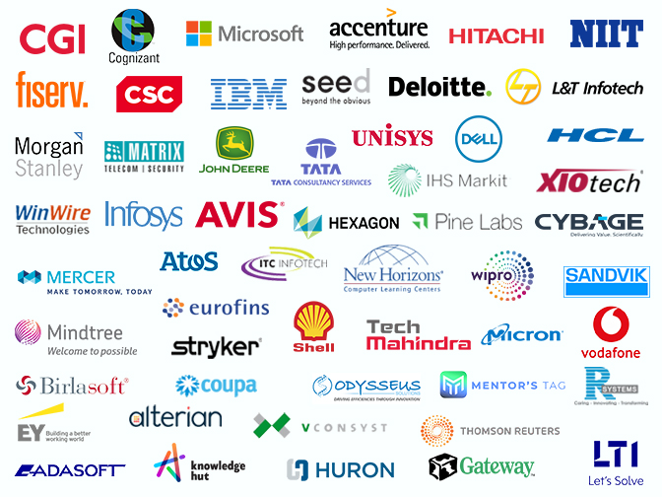

Maruti Makwana
MICROSOFT CERTIFIED TRAINER

Slide 3
Hope you have installed
NPM
Angular CLI
Visual Studio Code

Slide 4
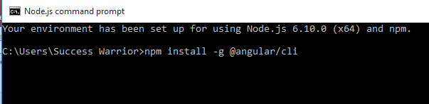
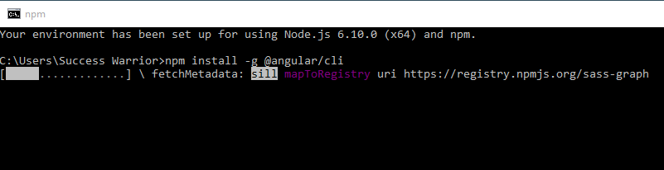
Now install angularCLI

Slide 5
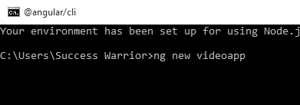
Time to create new angular project

Slide 6
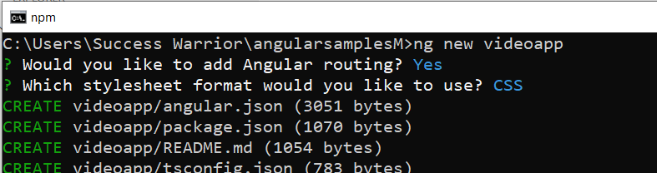
Cd video

Slide 7
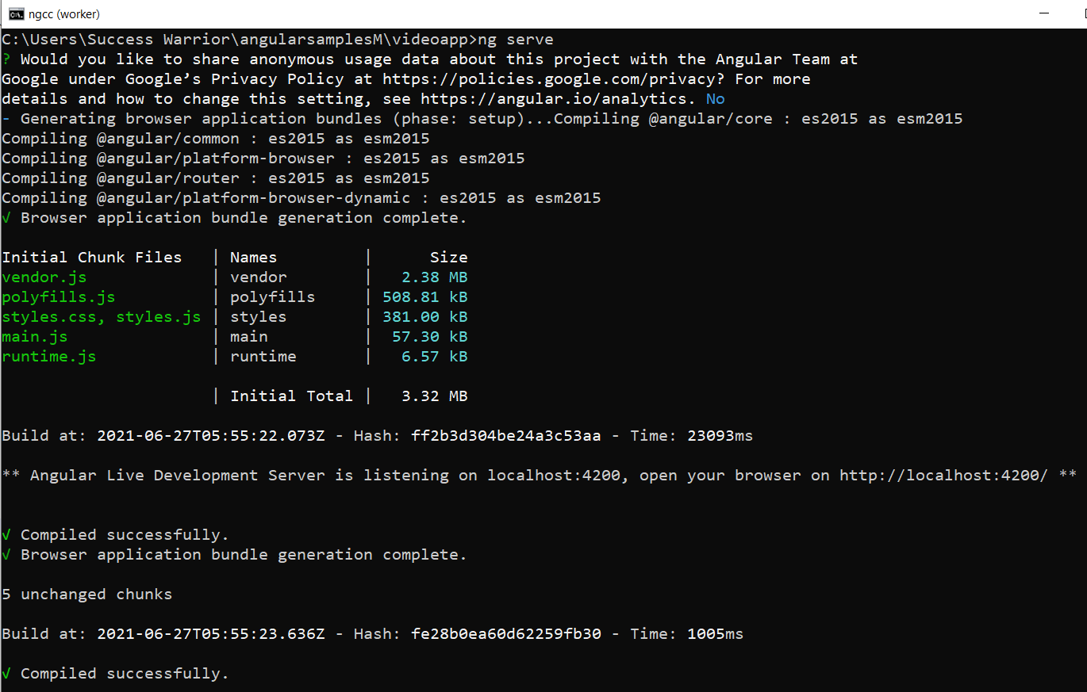

Slide 8
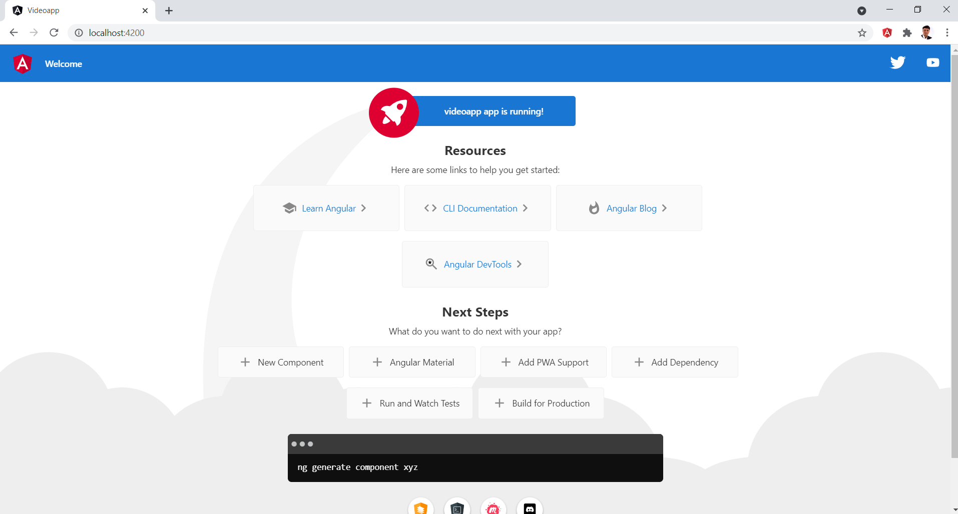

Slide 9
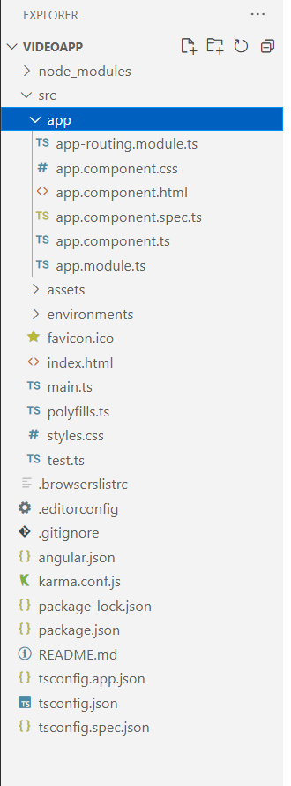
Open app in VS Code

Slide 10
approuting
browser
appmodule
appcomponent

Slide 11

Component
Angular
Module

Slide 12

Class
Component
Template
Metadata
Properties
Methods
HTML View
Extra data for Angular
Data
Logic

Slide 13
App.component.html
App.component.ts
App.module.ts
main.ts
Angular.json
Angular Frmwrk
Index.html

Slide 14
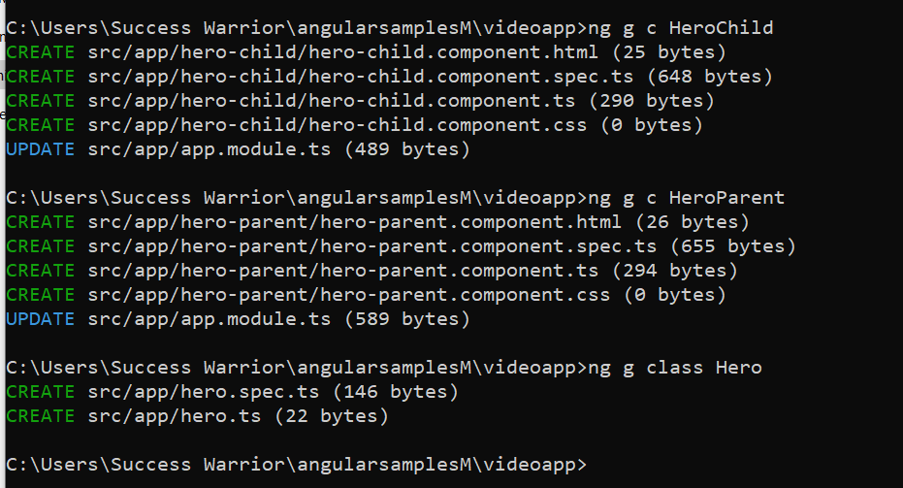

Slide 15
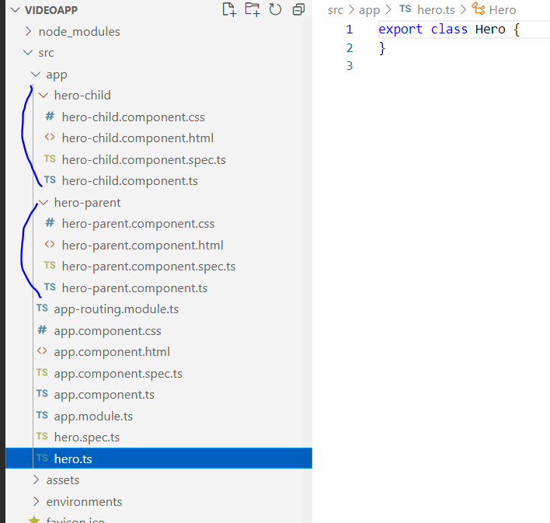

Slide 16
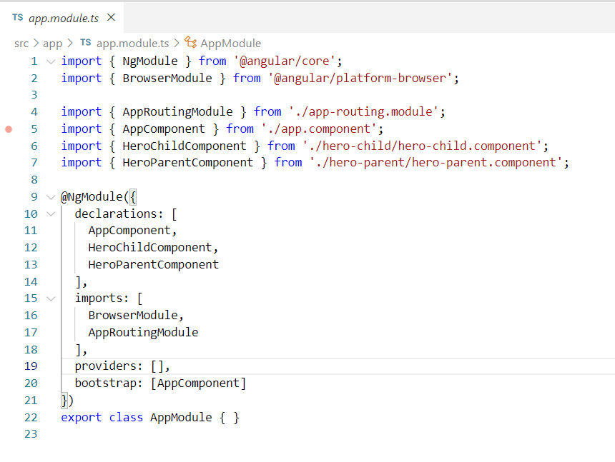

Slide 17
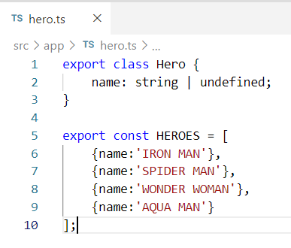

Slide 18
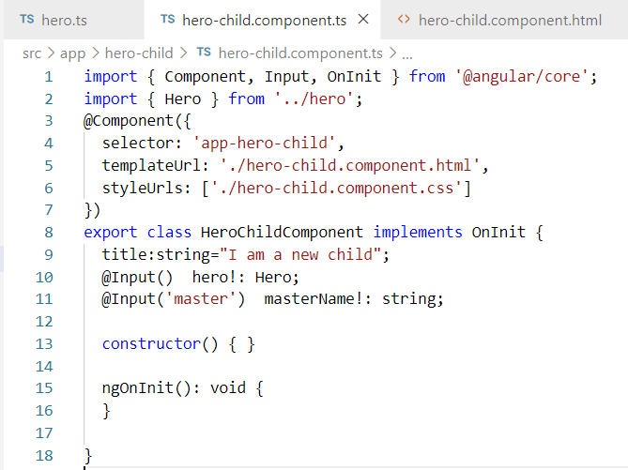

Slide 19
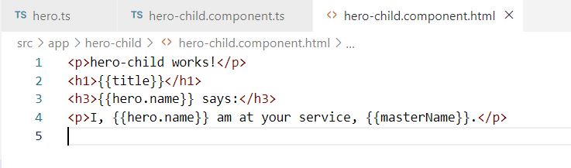

Slide 20
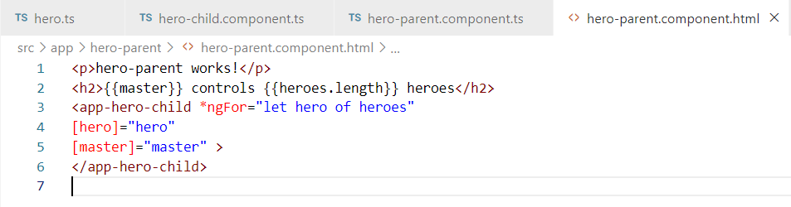
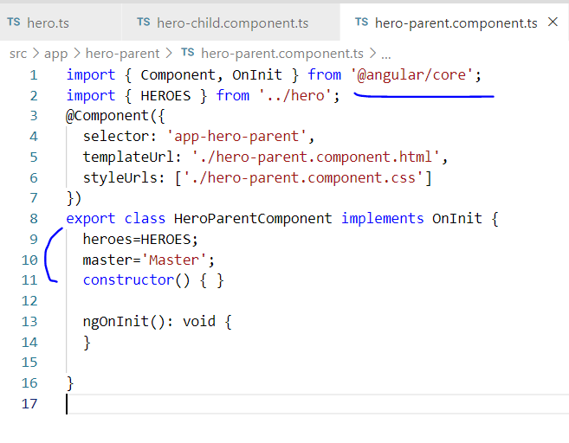

Slide 21
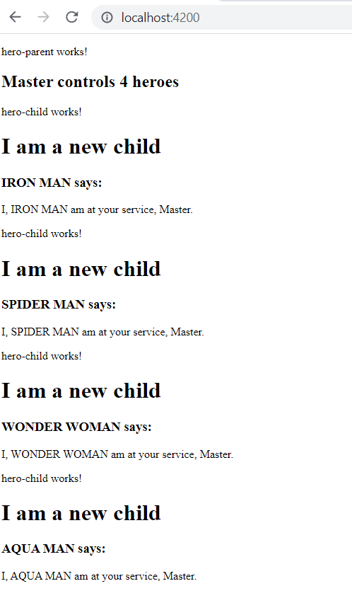

Slide 22
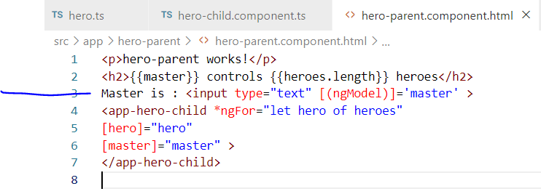

Slide 23
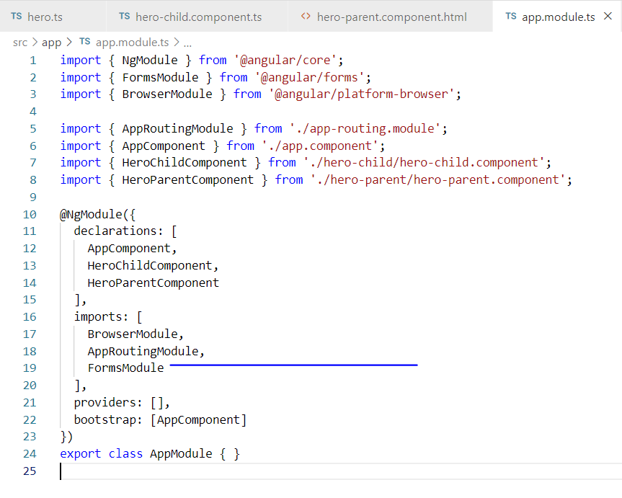

Slide 24
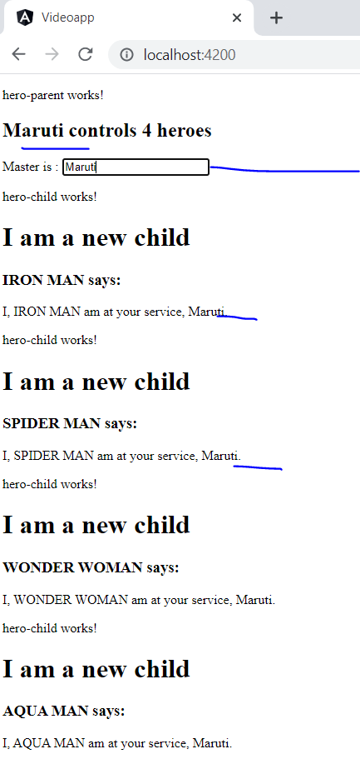

Slide 25
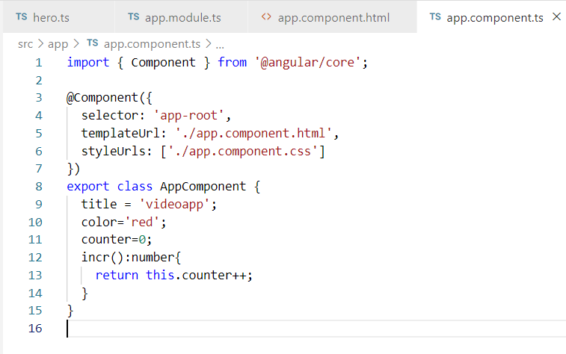

Slide 26
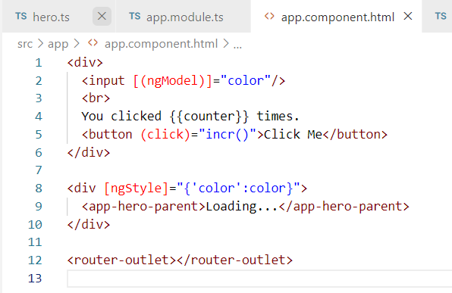

Slide 27
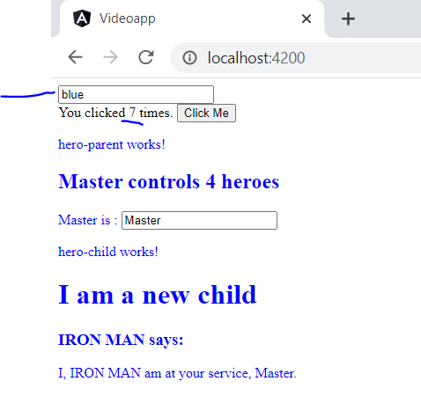

Slide 28
Template
Component
Module
Bindings- 4 types
Directives
Decorators

Slide 29
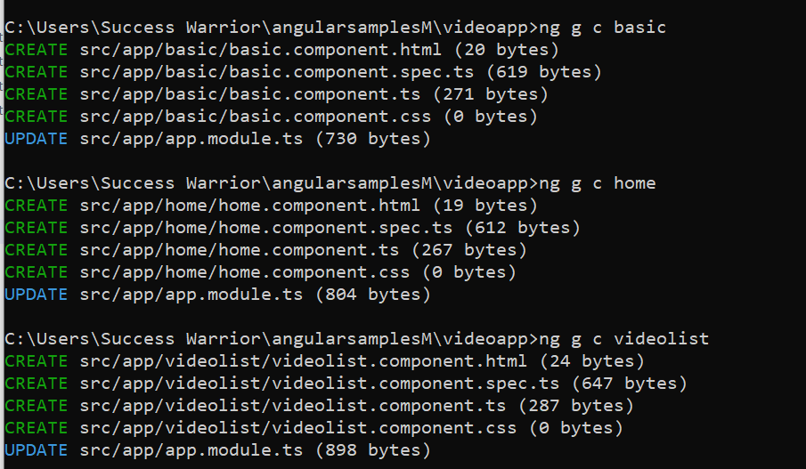

Slide 30
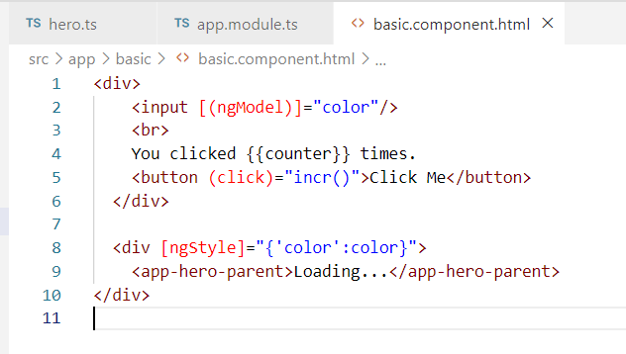
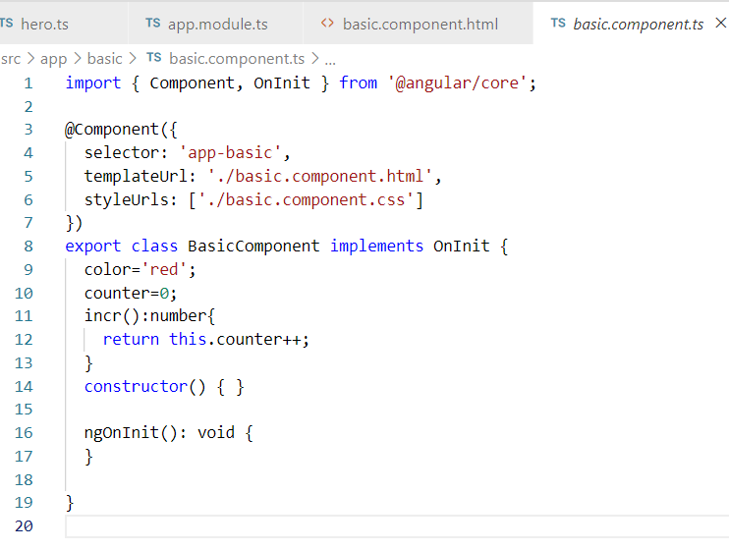

Slide 31
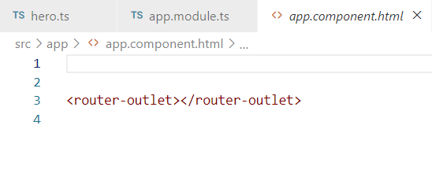
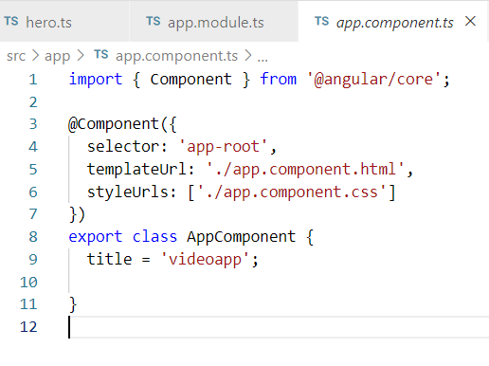

Slide 32
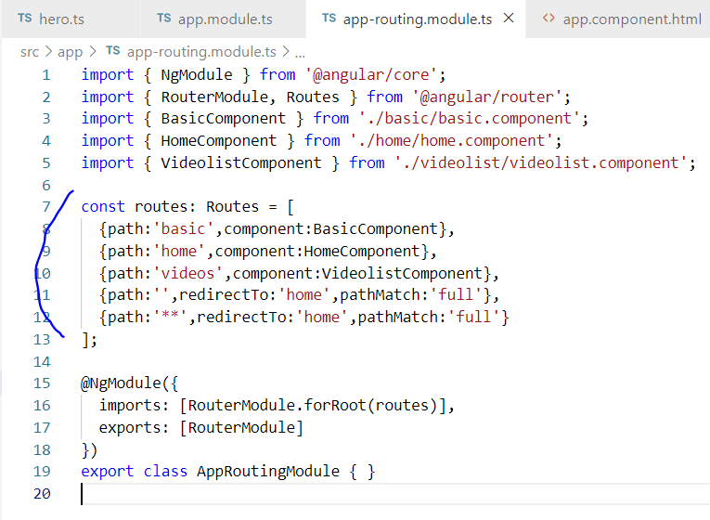

Slide 33
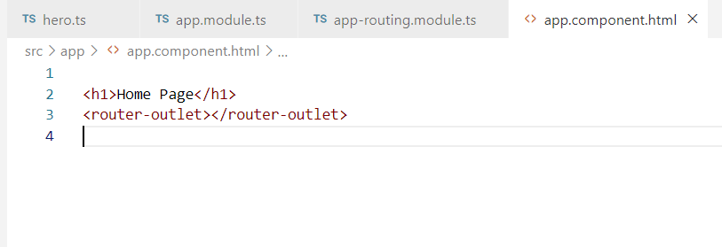
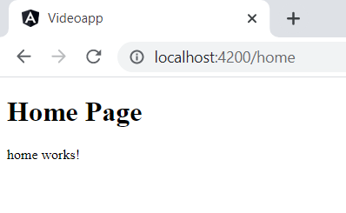

Slide 34
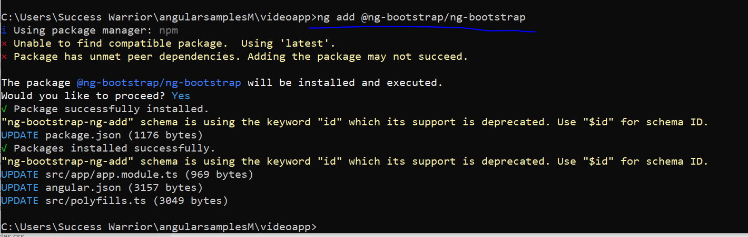

Slide 35
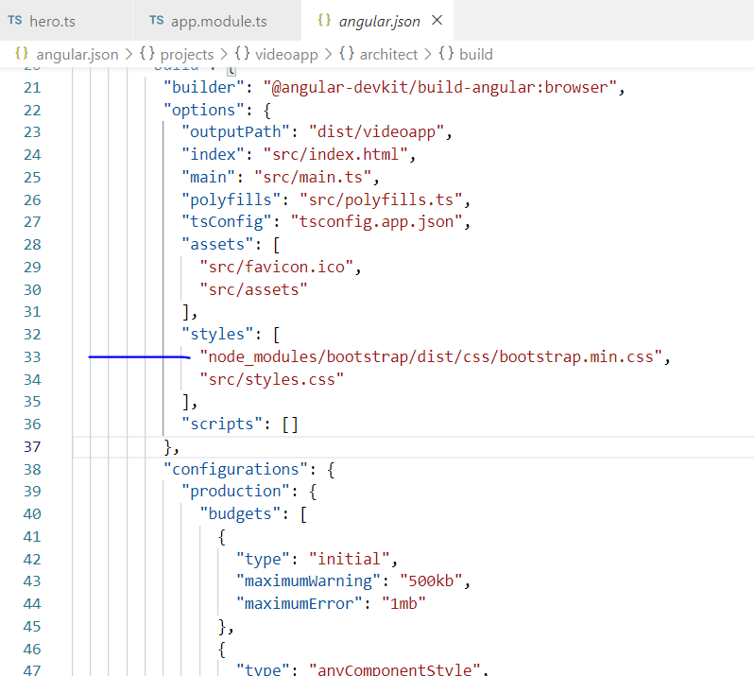
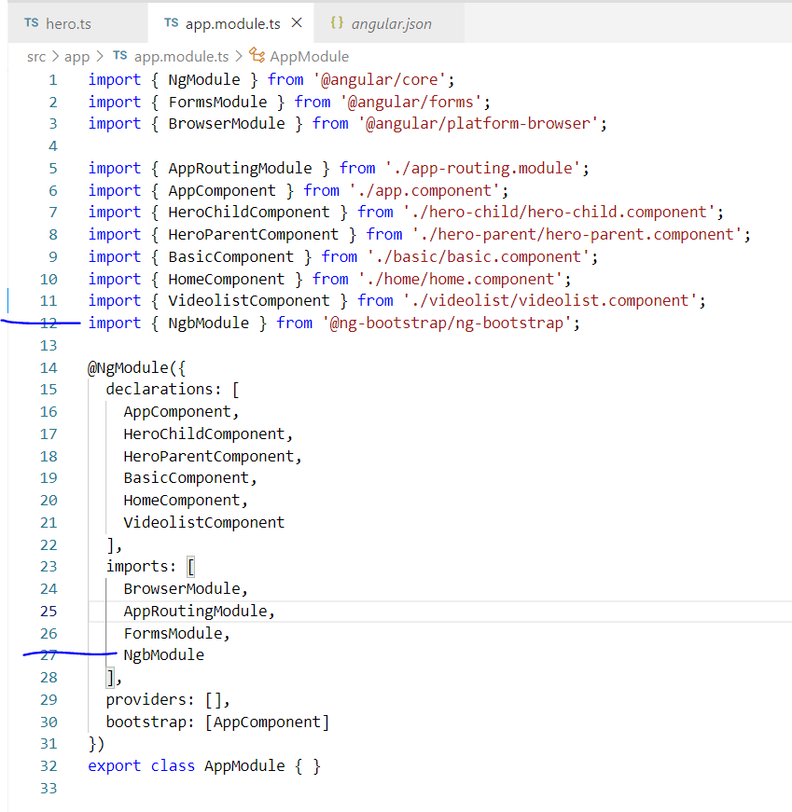

Slide 36
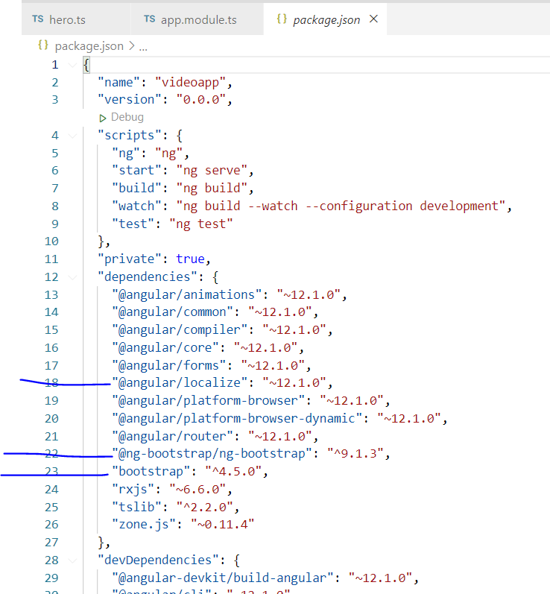

Slide 37
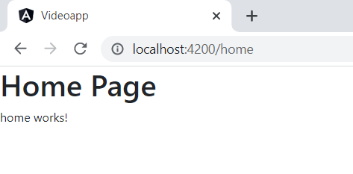

Slide 38
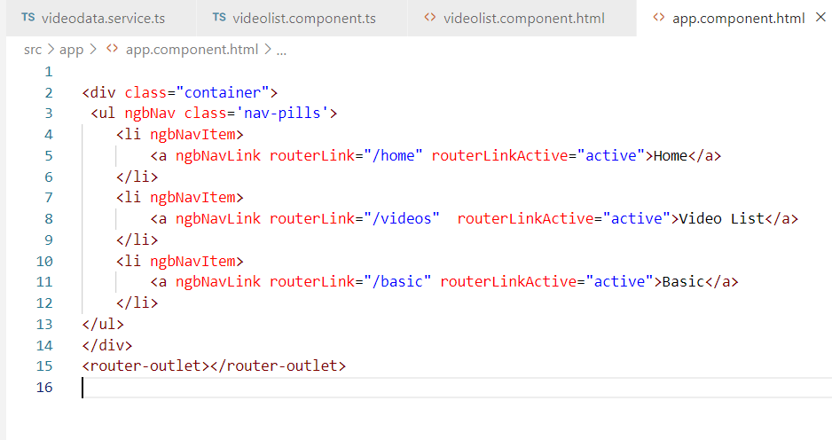

Slide 39
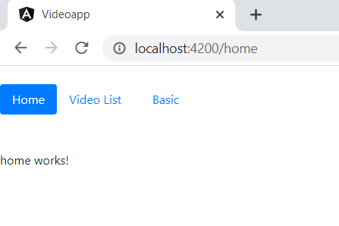

Slide 40
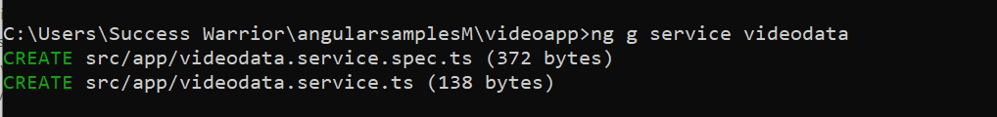
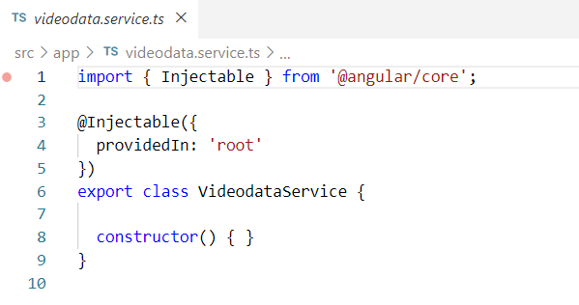

Slide 41
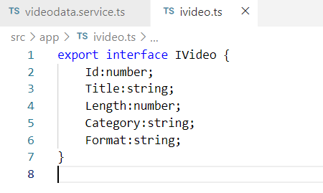

Slide 42
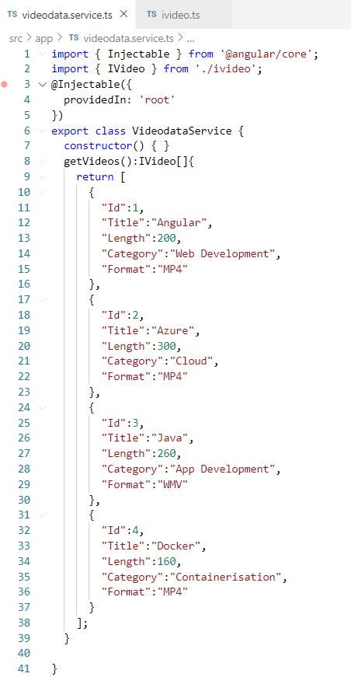

Slide 43
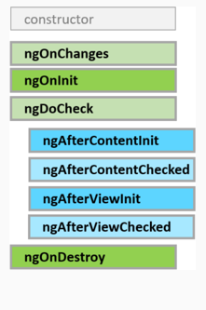
Component
Lifecycle
Hooks
A directive has the same set of lifecycle hooks, minus the hooks that are specific to component content and views.

Slide 44
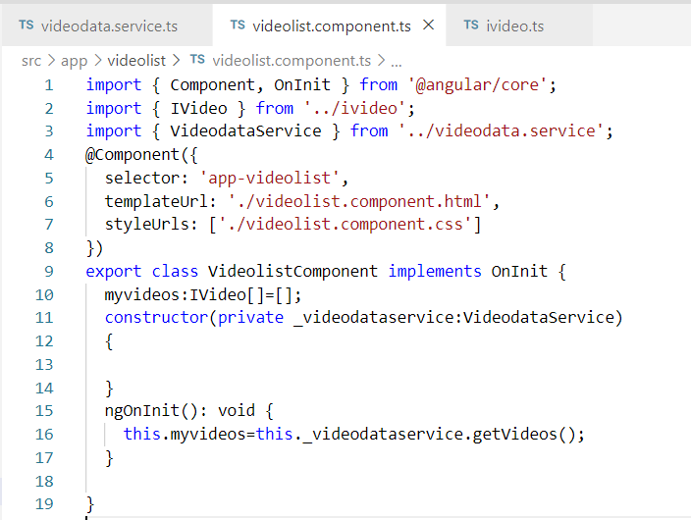

Slide 45
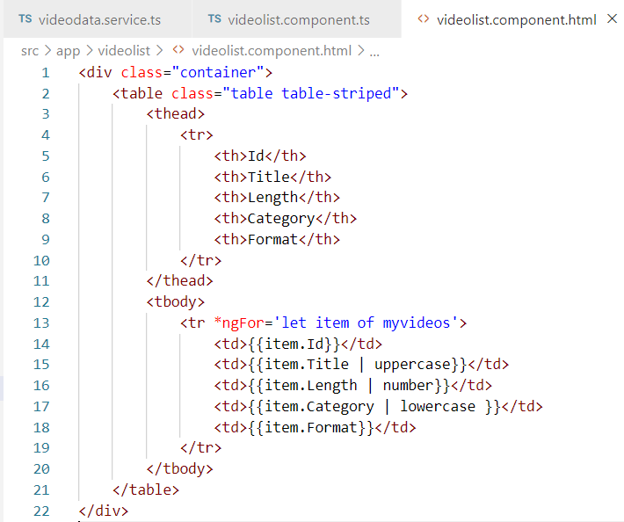

Slide 46
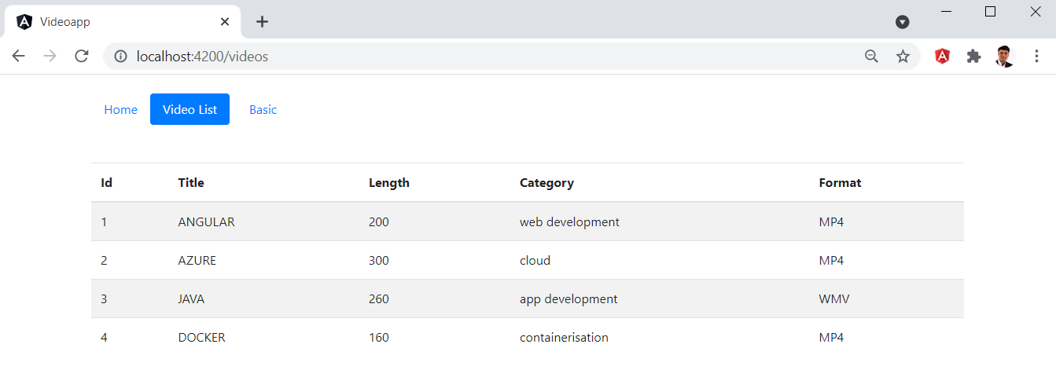

Slide 47
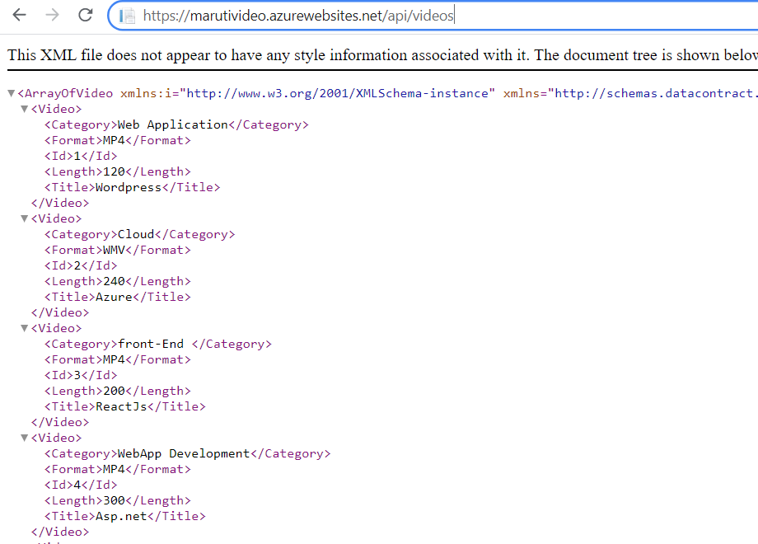
https://marutivideo.azurewebsites.net/api/videos

Slide 48
Angular Service
Reactive Exts
http
client
observables

Slide 49
subject
observables
subscribers

Slide 50
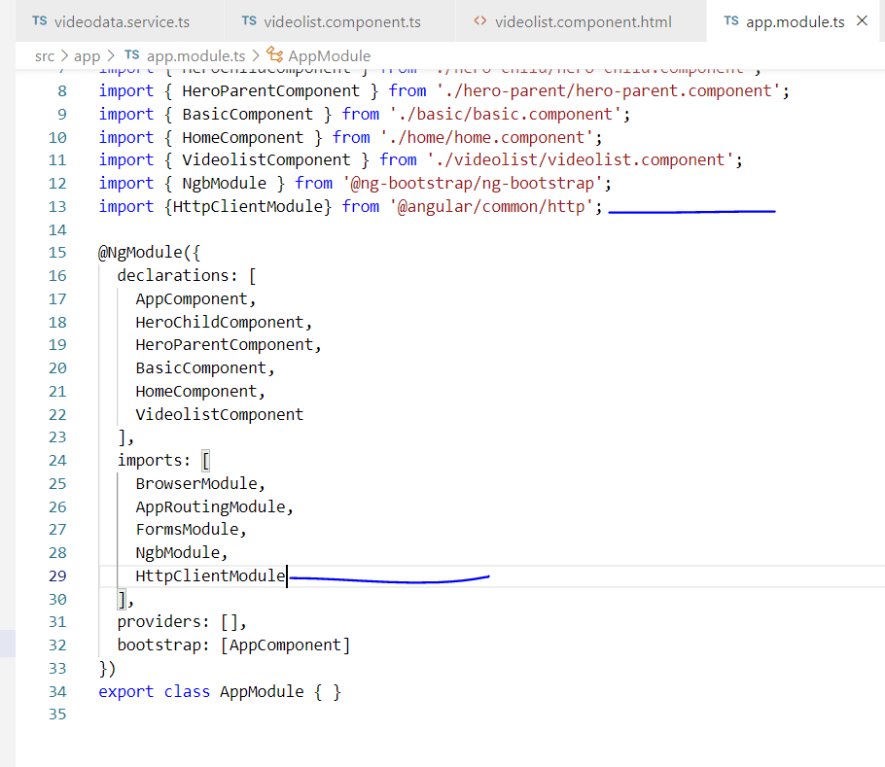

Slide 51
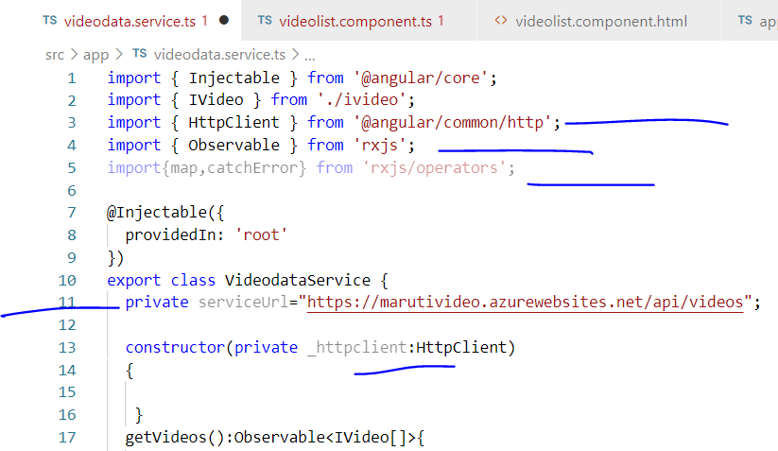

Slide 52
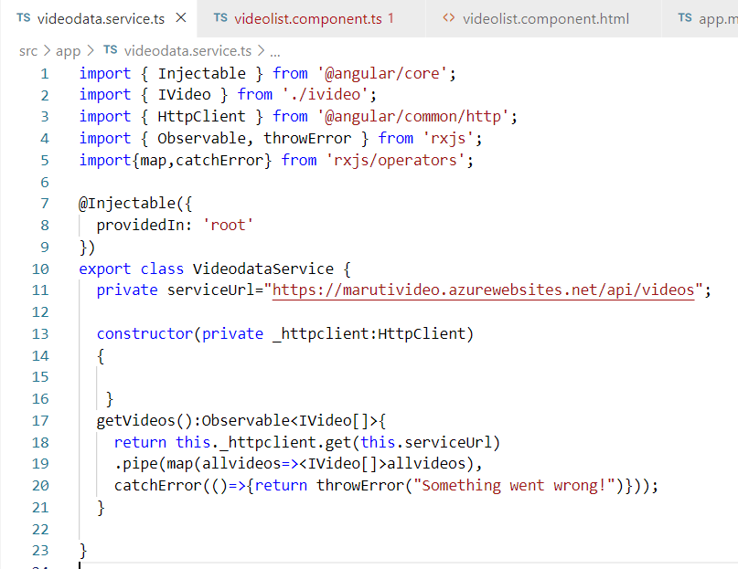

Slide 53


Slide 54


Slide 55
Template
Component
Module
Bindings- 4 types
Directives
Decorators
Hooks
Services
Dependency injection
Routing
Angular Application architecture

Slide 56

Angular devtools

Slide 57
approuting
browser
httpclient
forms
ngbmodule
appmodule
basic
Home
appcomponent
videolist
videodataservice

